Slide 1



learn invent impact
XCSG: Schema for naming program artifacts and relations
Suresh C. Kothari
Department of Electrical and Computer Engineering
President & Founder EnSoft Corp.
Acknowledgement: Team members at Iowa State University and EnSoft, DARPA contracts FA8750-12-2-0126 & FA8750-15-2-0080

Slide 2
Why a naming schema?
Searchable graph
Queries to search the graph
Queries
Need names for items to search
A naming schema for graphs representing software
Program artifacts
Nodes
Nodes and edges have tags or attributes for their names
Relations
Edges
Nodes | function, loop header, branch node, control flow node
Edges | successor, function call, containment
Subgraphs | loop body

Slide 3
eXtensible Common Software Graph (XCSG) schema
Open-source XCSG schema for naming program artifacts:
eXtensible (X): it is extensible to several programming languages + extensible to artifacts derived by analysis
XCSG
Common (C): it makes use of commonality across different programming languages to provide language agnostic naming
Software Graph (SG): it is for naming nodes and edges in graphs representing software
New types and tags can be registered to extend the existing set of types and tags.

Slide 4
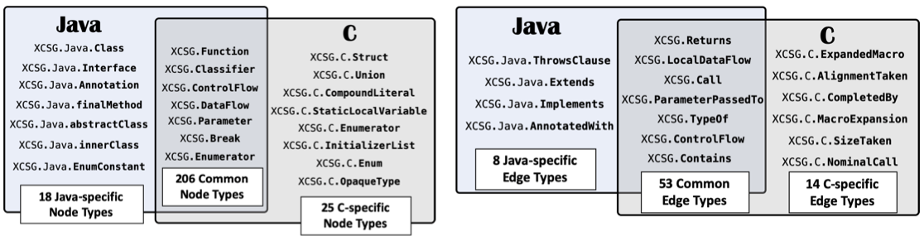
XCSG: Nodes and Edge types for C and Java
XCSG enables a harmonious representation of software written in different languages

Slide 5
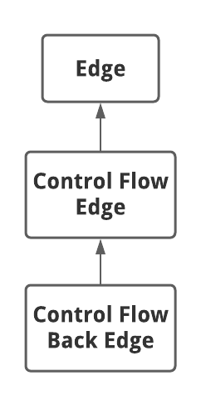
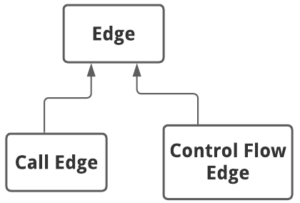
Edge Hierarchy
Super-type
Sub-type

Slide 6
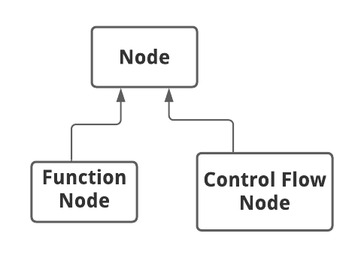
Node Hierarchy
Super-type
Sub-type

Slide 7
Tags instead of subtypes
As shown on previous slides, we mostly use subtypes. However, as illustrated here, in some scenarios the tags provide a better alternative.
Scenario: If a node subtype of Statement has TRUE and FALSE outgoing edges. TRUE and FALSE are tags for edges, they are not subtypes.
Since IF and SWITCH are both subtyped as branch nodes, the naming scheme for the outgoing edges for both should be the same. What should be the naming for outgoing edges of SWITCH?
Varying number of outgoing edges of SWITCH have as tags the values associated with different cases.

Slide 8
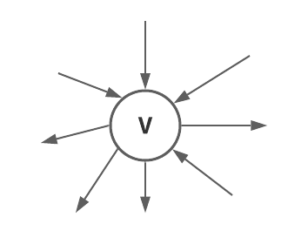
Compatibility of Nodes and Edges
Compatibility
Compatibility appropriate program semantics
Example: A CONTROL node is not compatible with CALLS edge
Explanation: A CONTROL node subtype is for nodes in the CFG. The edges between the CONTROL nodes are the SUCCESSOR relation. The CALLS edges are for the nodes with subtype FUNCTIONS.
XCSG specifies compatibility of each subtype of node with subtypes of edges.

Slide 9
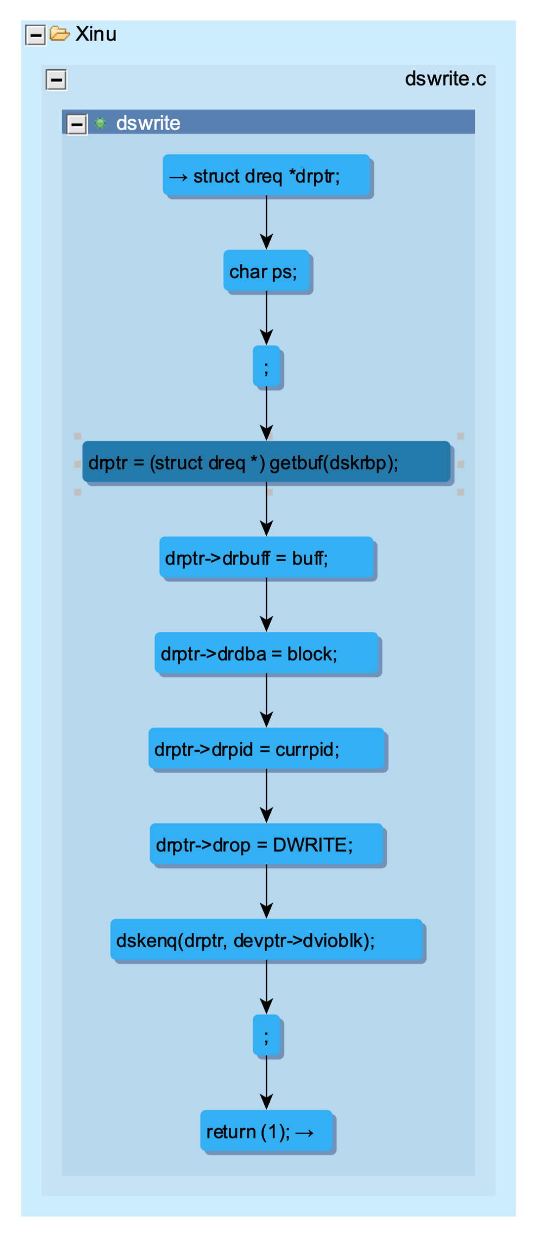
API out(): gives outgoing edges from node
We will use the API out() at the selected node.
Select a control flow node by clicking (darkened)
What should be the answer?
CFG for the dswrite function in XINU

Slide 10
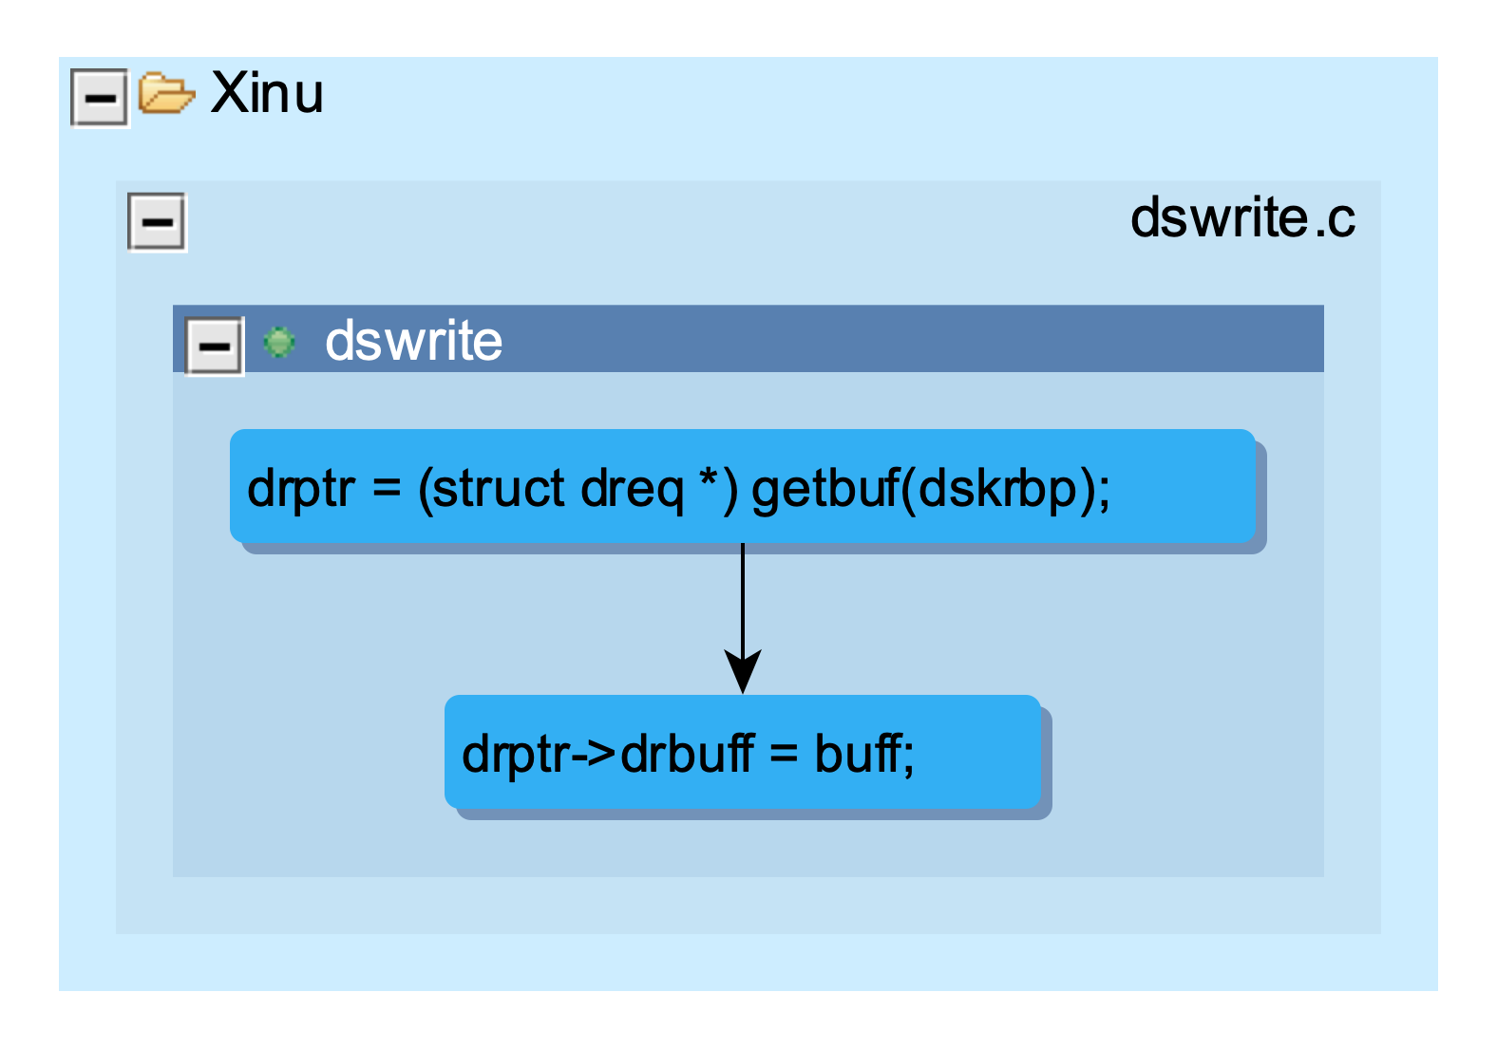
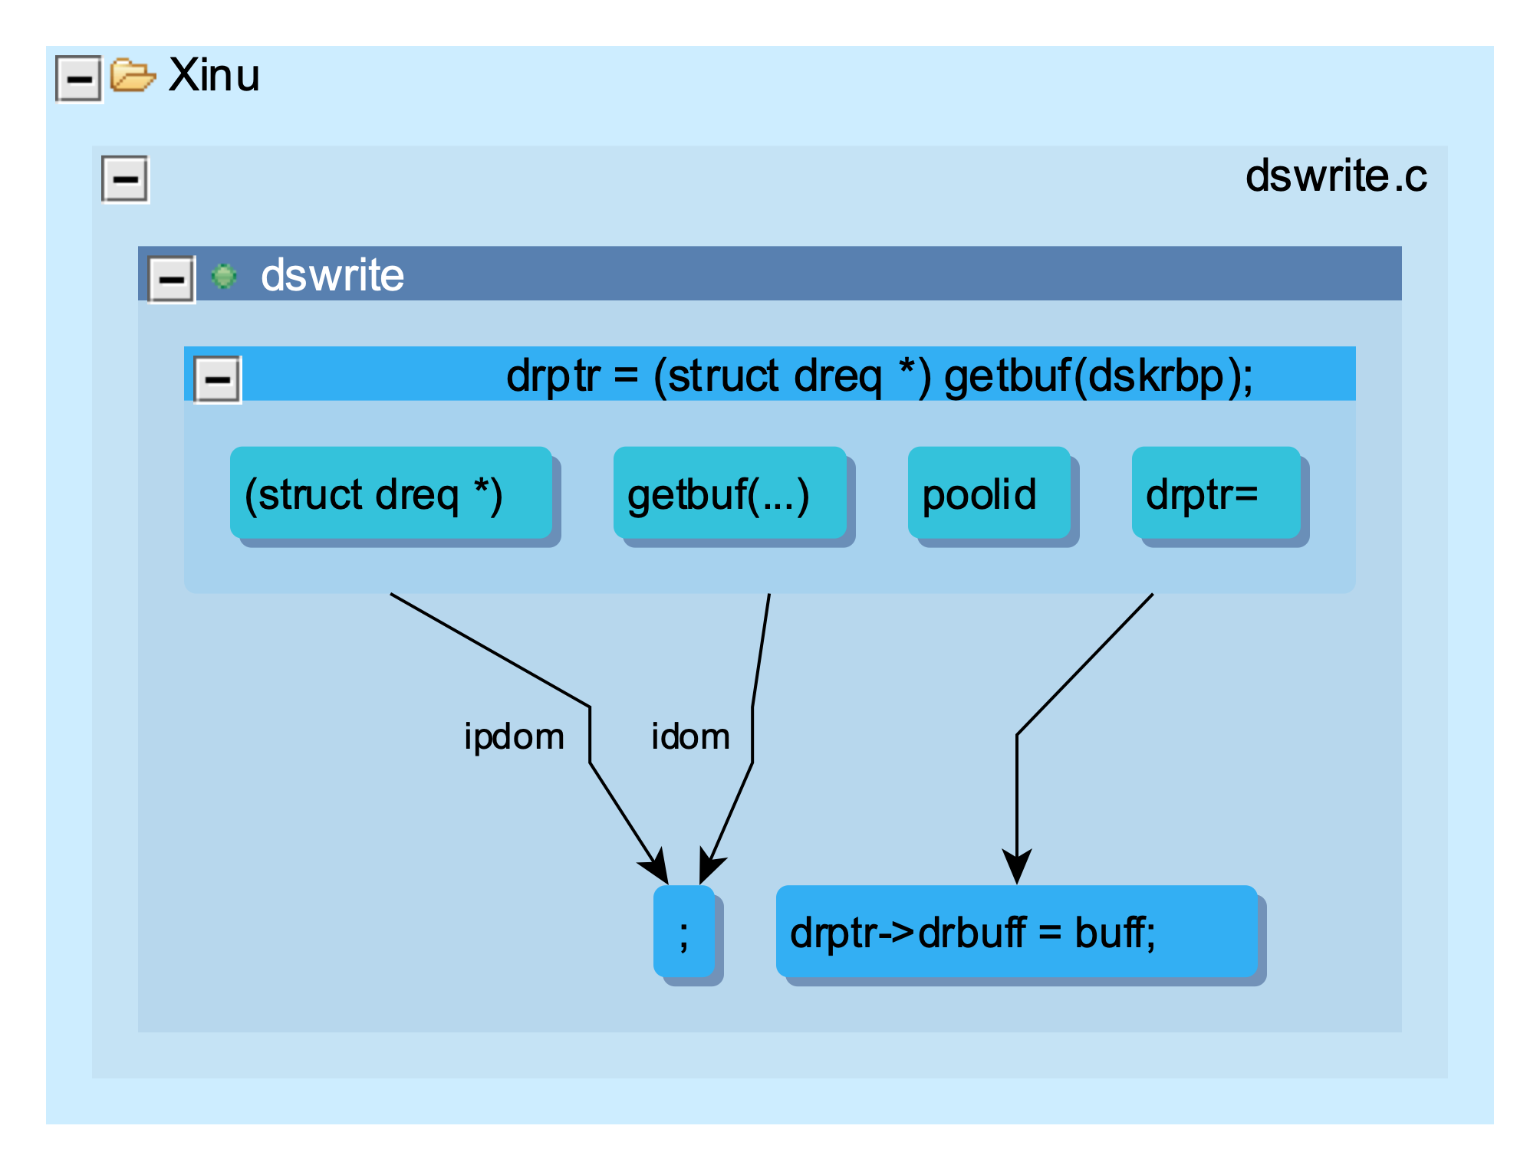
Expected Result of out()
Actual result

Slide 11
out() has captured:
Expected: outgoing control flow edge (shown in the dotted box).
Unexpected: Four nodes shown in a box and two other edges.
Mystery:
What is the unexpected information for?
Why is it captured?
We will need new concepts to solve the mystery

Slide 12
``IS’’ Hierarchy
A naming scheme for graphs requires:
``IS’’ Node and ``IS’’ Edge
Animal
Node
Mammal
Type Hierarchy
Think of it as the ``IS” hierarch
Control Node
Human
Example: mammal IS animal
Branch Node
SWITCH Node
Loop Header

Slide 13
``CONTAINMENT’’ Hierarchy
Why CONTAINMENT?
Software is a graph of graphs
contains
D
A contains B; B contains C;
C contains D and E. All are nodes.
A
contains
B
contains
C
contains
E
A
B
Alternate Visualization
C
D
E
# CONTAINMENT EDGES = # Concentric rectangles - 1

Slide 14
``CONTAINMENT’’ hierarchy in software
XINU package
dswrite.c file
dswrite function
Control Node
X1
X2
X3
What could x1, x2, x3 be?

Slide 15
The graph inside a control node
Preamble: Control node is for a program statement, and it is connected by the successor one or more edges which are for the next statements to be executed.
The control node C(S) for statement S must capture the complete semantics of S. The control node contains a graph to capture the semantics.
Let’s do examples to understand the graph is contained in the control node
S: z = x + y
Z=
+
Statement S will be connected nodes S1 and S2 for x and y. S1 and s2 are called the data flow nodes. We will study them later.
S: z = a + b*c
Z=
+
Statement S will be connected to nodes S1, S2, and S3 for a, b, and c.
*

Slide 16
Node CONTAINMENT examples for control nodes
S: z = x + y
z =
+
S
z =
+
S
S: z = a + b*c
z =
+
+
*
z =
*

Slide 17
A node CONTAINMENT example with a callsite
S:
Assignment
Return
Callsite
drptr =
(struct dreq *)
getbuf(.)
Formal parameter
FP
S
drptr =
(struct dreq *)
getbu(.)
FP
The graph inside the control flow node is called Abstract Syntax Tree – semantics of executing a statement

Slide 18
Mystery: What is the unexpected information for? Why is it captured?
Solved !
7 CONTAINMENT Edges
FP is poolid
Immediate dominator Edge
Successor Edge
Immediate post dominator Edge
We will study dominator relation later
Frances Allen introduced the successor and dominator relations in her pioneering paper https://www.cs.columbia.edu/~suman/secure_sw_devel/p1-allen.pdf

Slide 19
Element Detail View (EDV)
Purpose: Get XCSG information for a node or an edge by selecting it. You also get the the line number in the source file corresponds to the selected node.
With EDV, you exactly know the attributes and tags and you can use that knowledge to write correct queries.
As we shall see later, EDV is required for developing Atlas plugin.

Slide 20
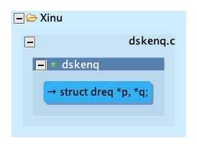
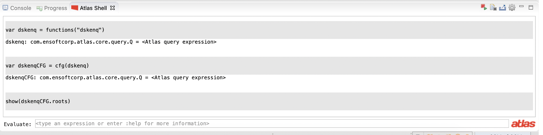
dskenq – CFG Roots
Concentric rectangles are used for CONTAINMENT
For proper context, the node is shown along with its parent function, C source file.
To show just the node without contextual detail, use the command:
show(dskenqCFG.roots, false)

Slide 21
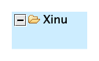

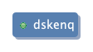
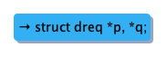
CONTAINMENT Relation
XCSG.Contains
XCSG.Contains
Folder icon denotes a project
Green colored small circle icon denotes a function.
struct dreq *p, *q; the arrow in front denotes that it is the root node of CFG
XCSG.Contains
Selected node

Slide 22
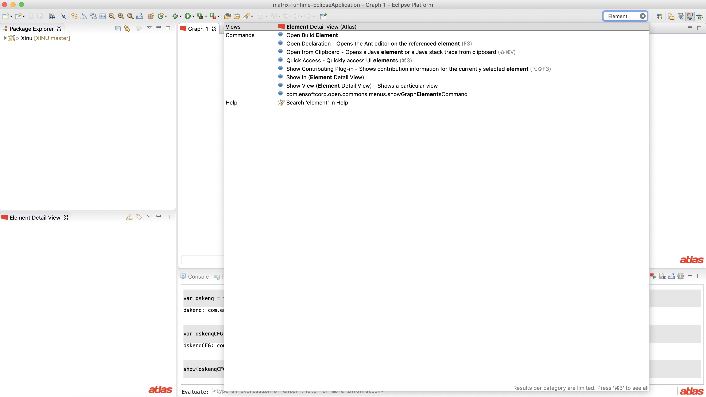
You can get EDV if you type Element in the Eclipse quick access box at the top right corner.
After selecting EDV, you can drag and drop it anywhere in the eclipse window.

Slide 23
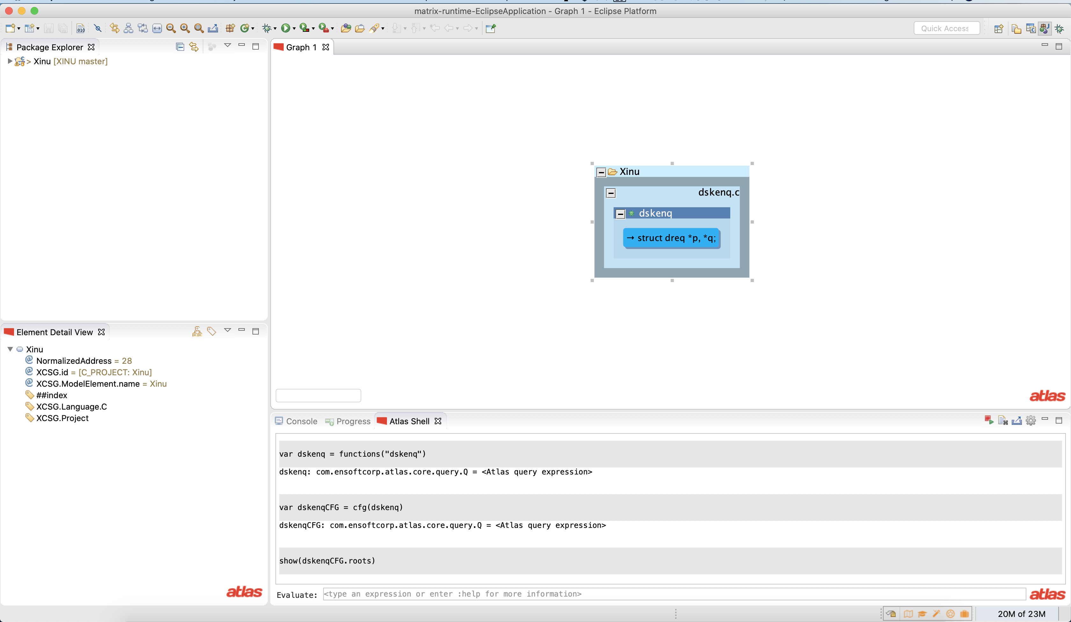
Clicking on the node Xinu, EDV shows that It is a project.

Slide 24
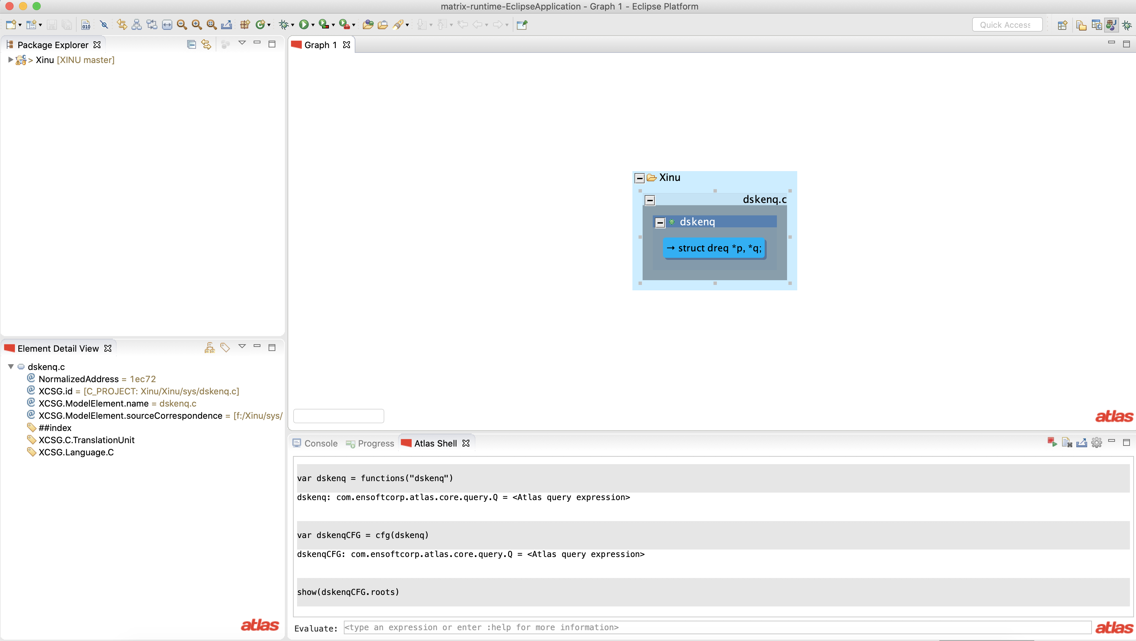
Clicking on dskenq.c, EDV shows that It is a translation unit. The output of the C pre-processor is called translation unit.

Slide 25
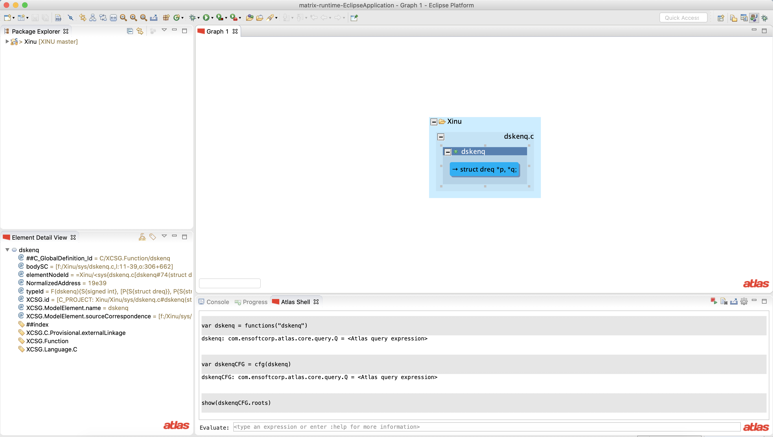
Clicking dskenq, EDV shows that It is a function

Slide 26
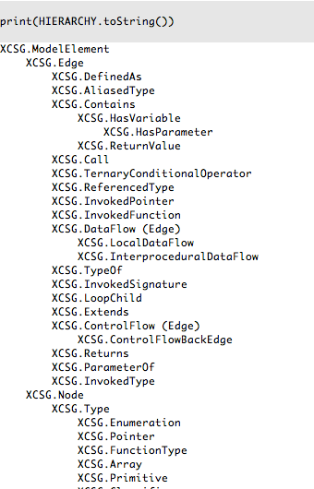
XCSG Hierarchy
You can learn more about XCSG hierarchy through Javadoc, look for com.ensoftcorp.atlas.core.xcsg.XCSG

Slide 27
Summary
Preamble: Software is a massively connected system. The abstraction is graph of graphs
Query language to perform searches and transformations on GG
Software
Graph of Graphs (GG)
Searchable GG
XCSG is a naming schema to make GG searchable
Nodes for program artifacts and Edges for relationships between program artifacts
“IS” and “CONTAINMENT” hierarchies in XCSG
Control Node for a program statement contains a graph that specifies the semantics for executing the statement. This graph is called the abstract syntax tree
Out query gives the outgoing edges of a node
CONTAINMENT Edges are shown as concentric rectangles
Element Detail View

